Slide 1
Quality Assurance in the Future World
Grant Klinkum, Deputy Chief Executive Quality Assurance
November 2016

Slide 2
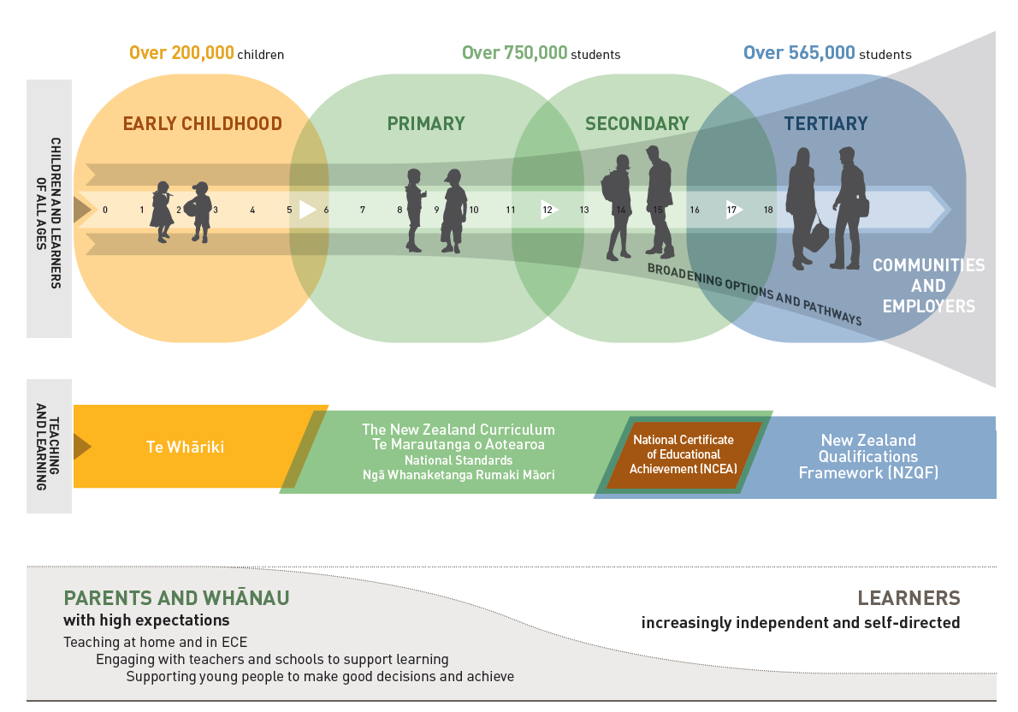
The New Zealand education landscape
Population 4.6 million
8 Universities
16 Institutes of Technology and Polytechnics
3 Wānanga
12 Industry Training Organisations
499 Private Training Establishments
2,500 Schools

Slide 3
NZQA’s role
Manages the New Zealand Qualifications Framework
Administers the senior secondary school assessment system
Sets the rules for quality assurance in the higher education sector
Improves the international recognition of New Zealand qualifications

Slide 4
NZQF provides transparency

Slide 5
The essence of the NZQF
Qualifications are ‘fit-for-purpose’
Meet the needs of industry, employers, society and the economy
Collaboration in the development of qualifications
Quality assurance processes ensure this

Slide 6
Transparency and trust
Transparency
The NZQF is based on learning outcomes
Robust processes for qualification development
Quality assurance of education providers
All information is publicly available

Slide 7
Transparency and trust
Trust engendered through:
Transparency of regulation, information and process
Clear outcomes of qualifications
Moderation of assessment
Consistency reviews
Sanctions for poor provision

Slide 8
The main building blocks
Front end quality assurance
Maintaining quality
Self-assessment
Periodic external evaluation and review
Active risk management

Slide 9
Balancing control and empowerment
High trust model
Flexible and robust regulatory system
Self-assessment encourages innovation and responsiveness
The balance is challenging to strike

Slide 10
Responsiveness to new challenges
Current systems
Needs of future learners
Quality innovation

Slide 11
Digital ASSESSMENT
“We are currently preparing student’s for jobs that don’t yet exist, using technologies that haven’t been invented, in order to solve problems we don’t even know are problems yet,” Richard Riley

Slide 12
QUALIFY FOR THE FUTURE WORLD

Slide 13
Questions?

